Slide 1
The inflammation

Slide 12
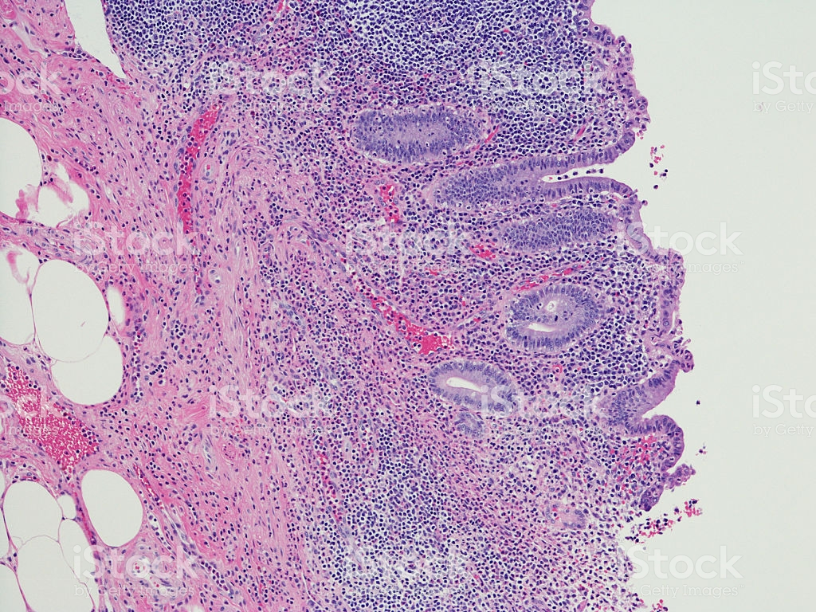
the organ: appendex
diagnosis: Acute inflammation
Lesion: infiltration of inflammatory cells(neutrephils)

Slide 15
Chronic inflammation infiltration of macrophages

